Slide 1


data@anz program
Virtual internship
Sothey sean

Slide 2
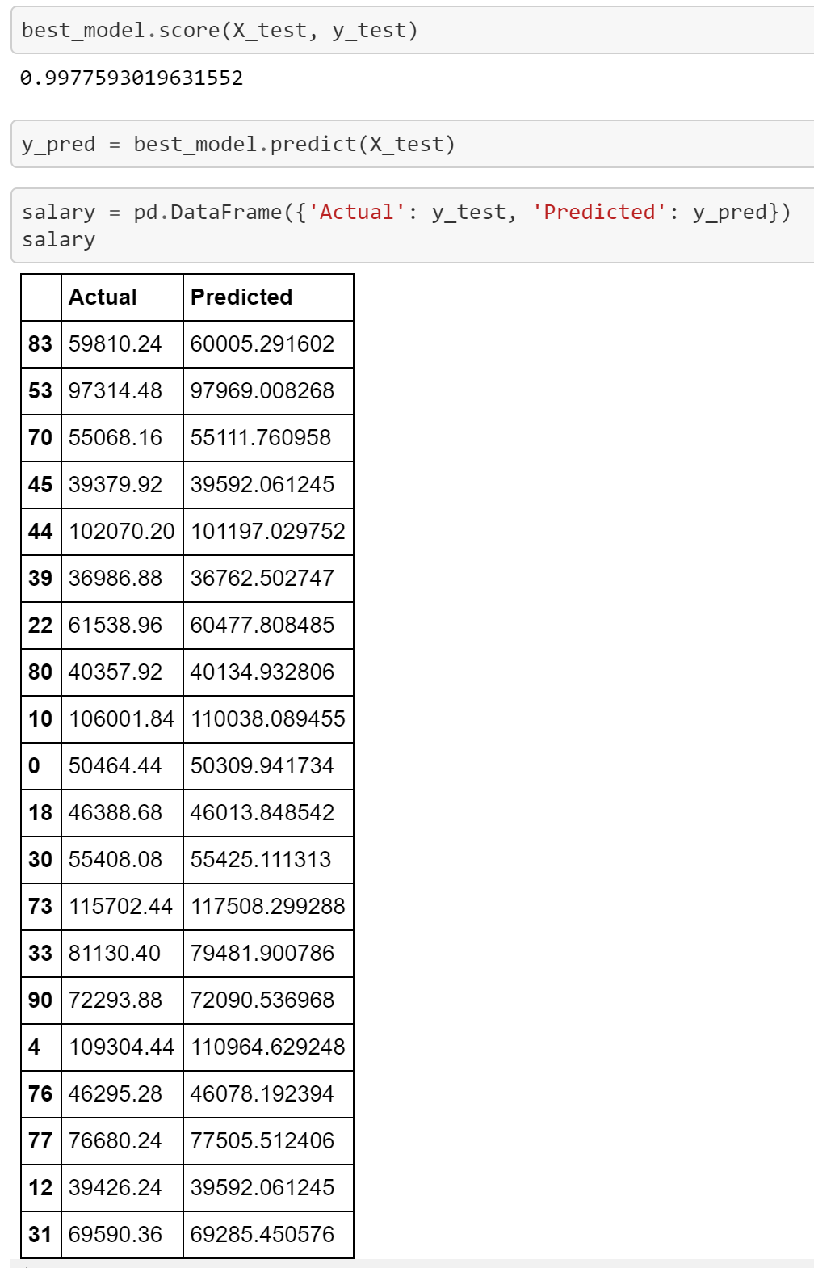
Regression Model
The accuracy of prediction was 99.77% when tested on new 20 customers.

Slide 3
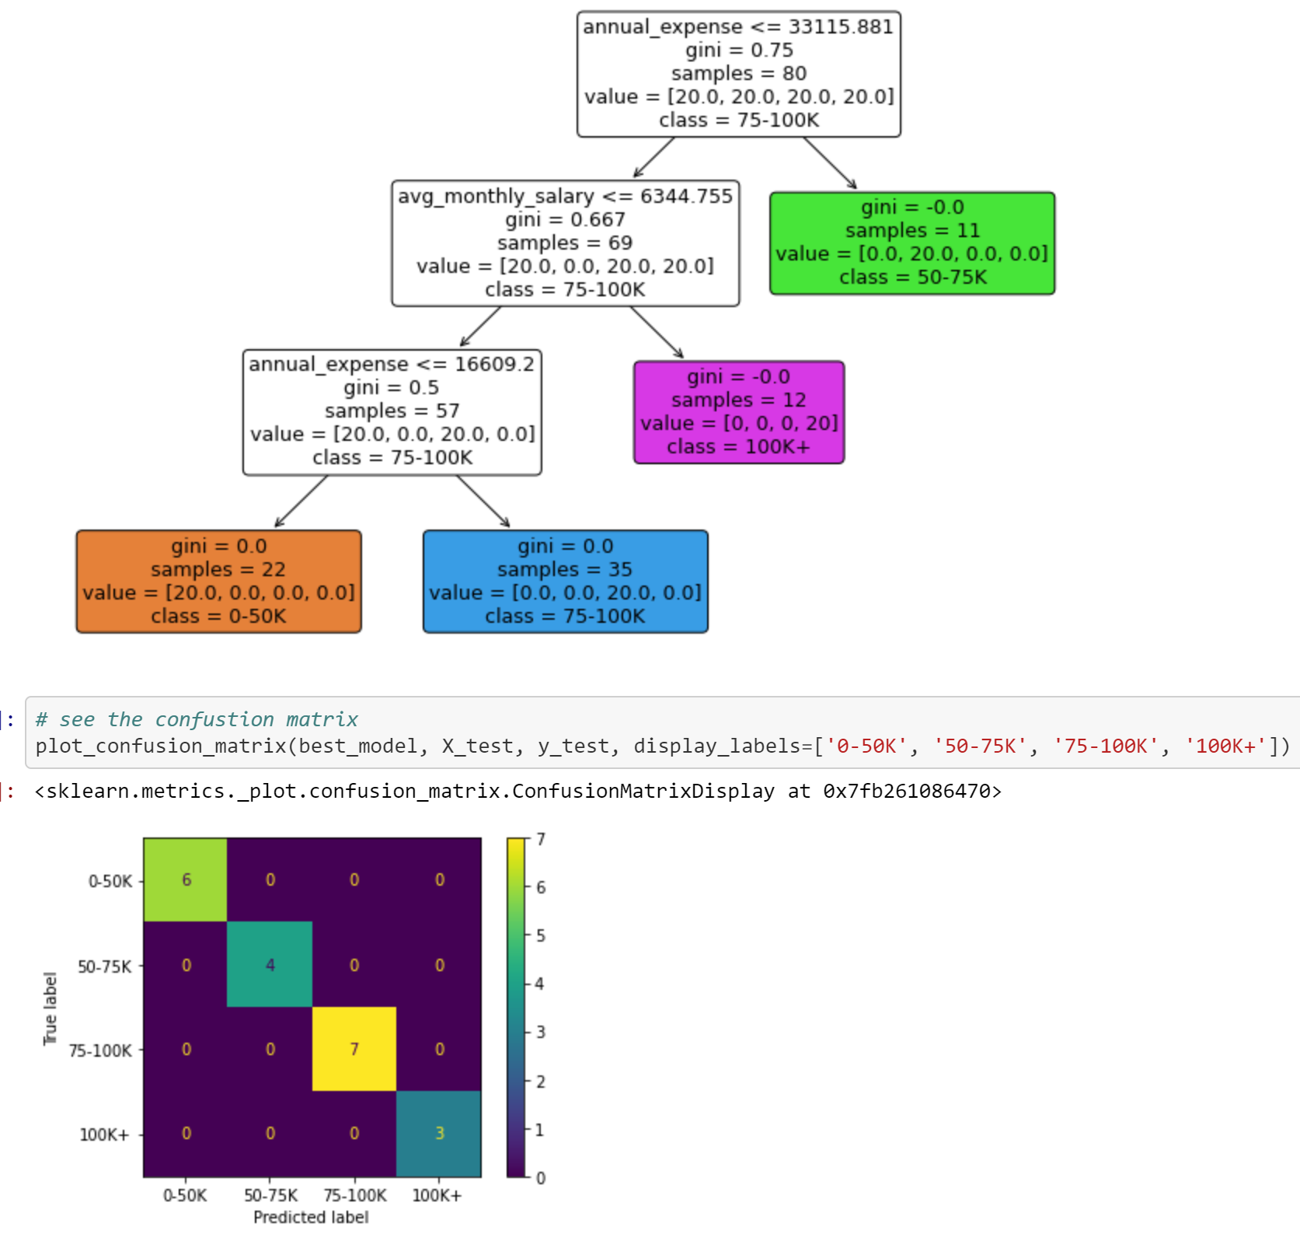
Decision Tree Model
Its’ performance was better than Regression Model, providing the accuracy of the prediction up to 100% when tested on new 20 customers. It was also verified in the confusion matrix table.

Slide 4
Source Code
The Python notebook is available in the github link below.
https://github.com/seansothey/ANZ-Virtual-Internship/blob/master/ANZ_Salary_Prediction.ipynb

